Slide 1

Seeding an express APP
VenkataSandeep

Slide 2




Leela Krishna
VenkataSandeep
Anvesh
Pavan
VenkataSandeep

Slide 3

Outcomes
VenkataSandeep

Slide 4
Outcomes
EJS
Passing a value
Passing objects
Getting data from DB
Inserting data into DB
VenkataSandeep

Slide 5
EJS
EJS is a simple templating language that lets you generate HTML markup with plain JavaScript
Client-side support
Control flow with <% %>
Escaped output with <%= %>
VenkataSandeep

Slide 6

Passing a value
VenkataSandeep

Slide 7
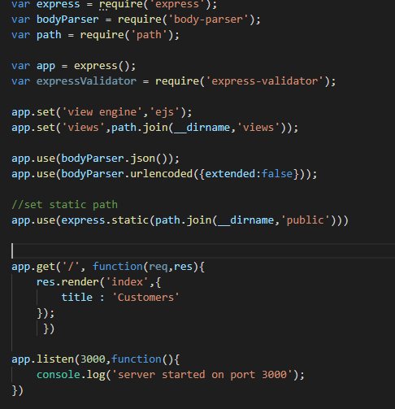
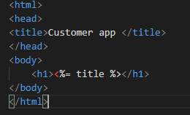
VenkataSandeep

Slide 8
Passing objects
Anvesh

Slide 9
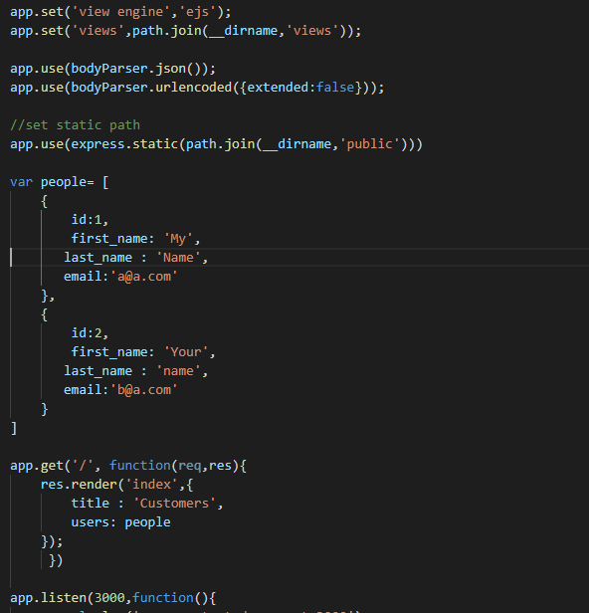
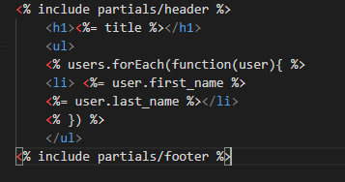
Anvesh

Slide 10
Getting data from DB
Pavan

Slide 11
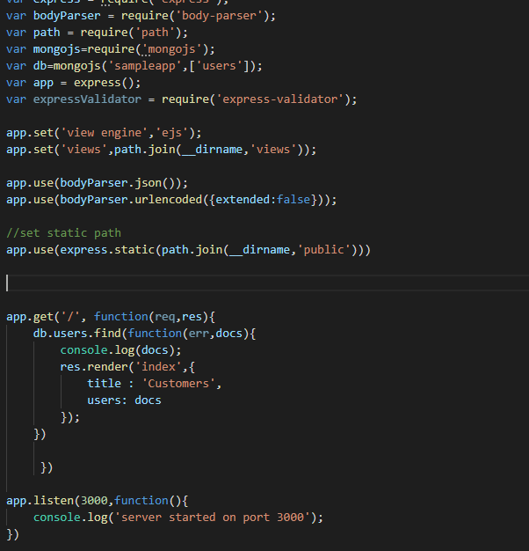
Retrieving array of objects from DB
Pavan

Slide 12
Inserting data into DB
Leela

Slide 13
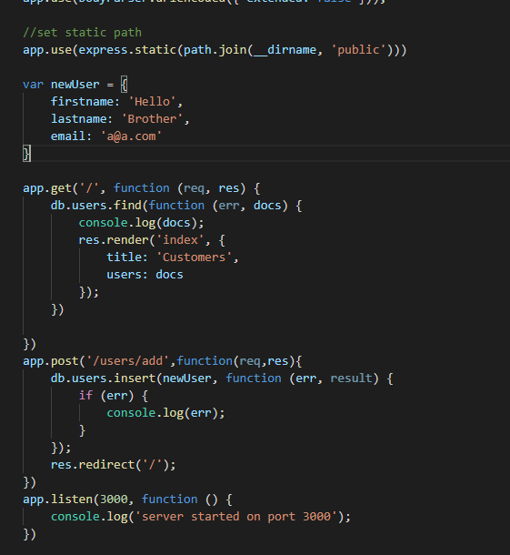
Inserting object into DB
Leela

Slide 14
Any Questions ???

Slide 15
Thank You ☺ ☺ ☺

